Slide 1


Streamline your work with WORKFLOW
Our Team: Anvee Shetye - Frontend Developer
Ashmit Shelke - Frontend Developer
Yash Shelar - Backend Developer
Project Supervisor: Dr. Gauri Shukla

Slide 2

Introduction
Workflow is an interactive website which helps you improve your retention span, keeps you invested in your tasks, and helps you achieve all your goals.

Slide 3

Objective
Our aim behind the development of this website is to have maximum concentration and efficiency while doing a task in sessions, with a serene workflow, supreme time management with prioritisation of tasks and great productivity with a great work environment

Slide 4
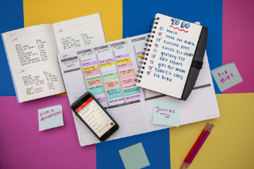
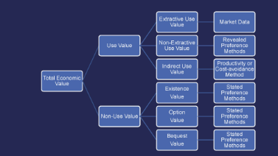


Features
To-Do List
Flowchart
Pomodoro Timer
Soothing Sounds
Don't forget anything and prioritize your tasks efficiently. Also keep a track of your accomplished tasks and get motivated with you achievements!
Get a clear understanding of your workflow and improve your productivity with visual mapping. Revise your topics and presentations quicker than ever!
Break your workday into manageable units of time to stay focused and refreshed. Customize the timer according to your comfort and cover up maximum work in powerful sessions!
Escape the noise of your environment and improve concentration with tranquil background music, choose the music that sets your mood the best!

Slide 5
Literature Review
Taskade Software
2
A task management feature with flowcharts and projects was inspired by Taskade Software.
1
2
Microsoft To-Do
1
A basic to-do list with minimalistic yet attractive UI was inspired by Microsoft To-Do.

Slide 6

Problem Statement
In today's fast paced work environments with an increasing number of tasks and varying priorities, there is a need for a task management system that includes a customisable pomodoro timer with a variety of backgrounds and themes, to-do list, customisable flowcharts, and soothing sounds.

Slide 7
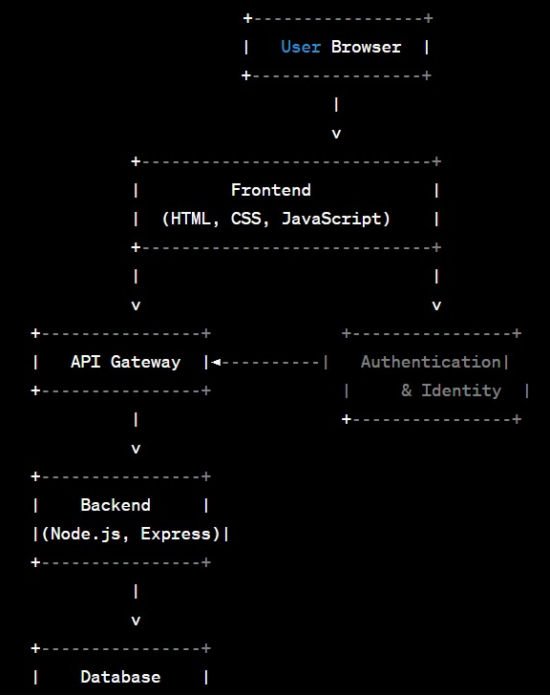
Architecture of the System
Our basic website is designed with a user browser, front-end, authentication and identity, API gateway, back-end (Node.js), and database (MongoDB).

Slide 8
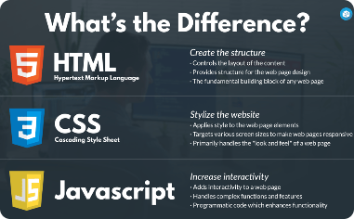

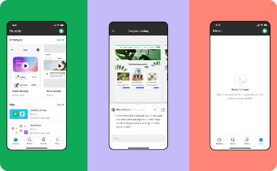
Technology Used
Frontend Development-
Node.js-
Figma
Node.js is a back-end JavaScript runtime environment and executes JavaScript code outside a web browser.
6
Figma is a browser-based interface design tool used for creating user experience designs, prototypes, and animations.
Front-end web development is the development of the graphical user interface of a website. It includes HTML, CSS , Javascript (backend).
7
4
5
3

Slide 9

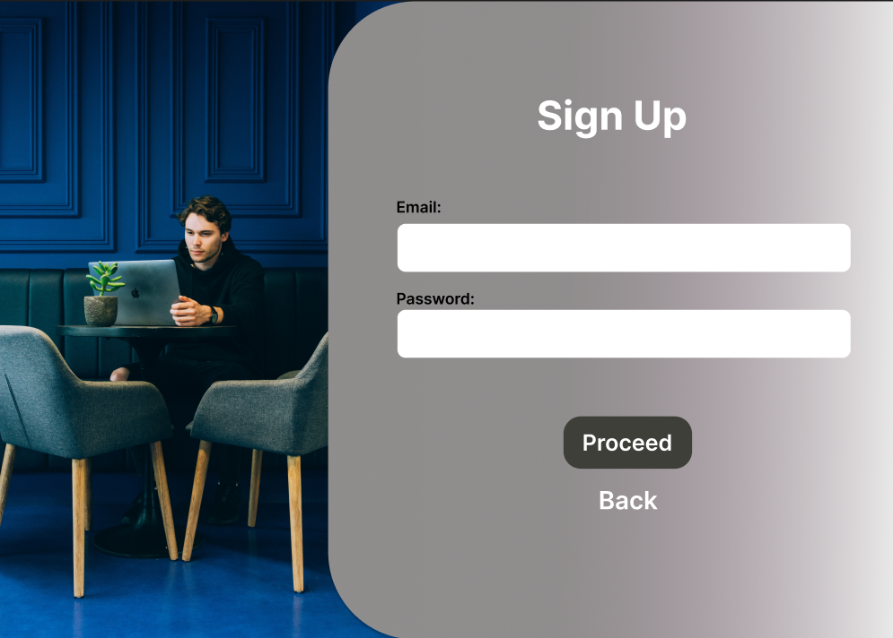
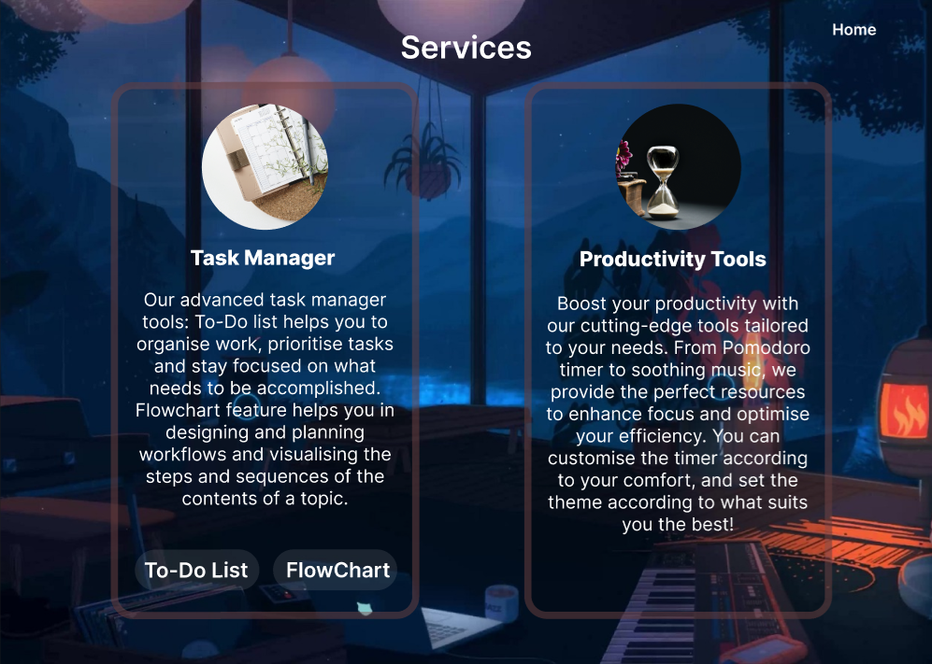
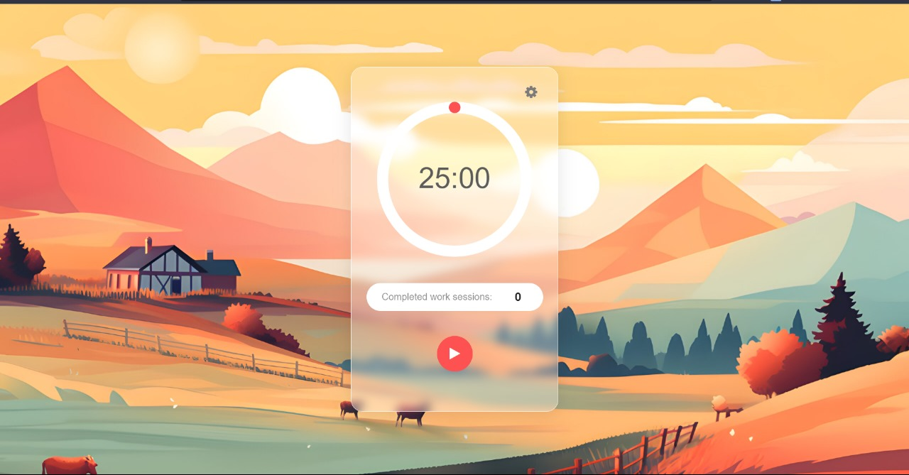
A Glimpse Of Implementation

Slide 10
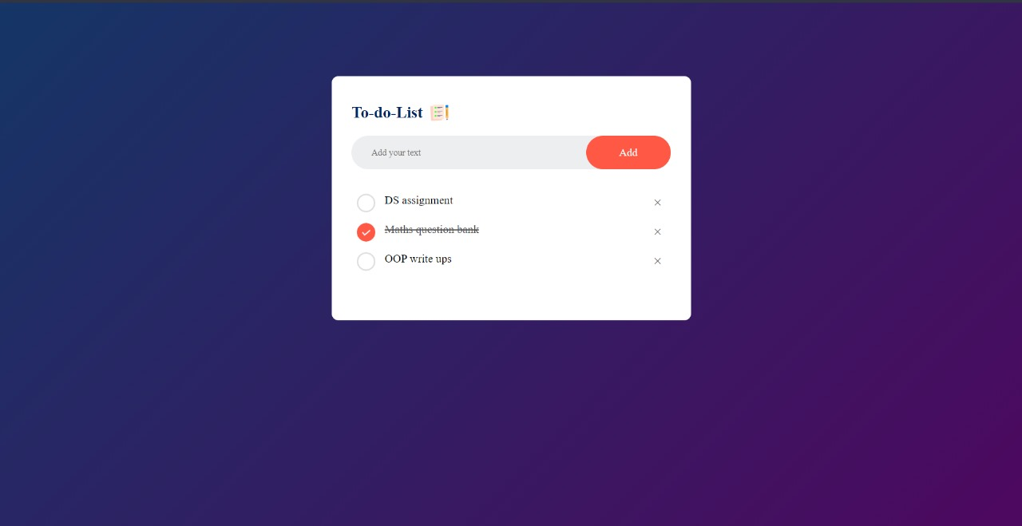
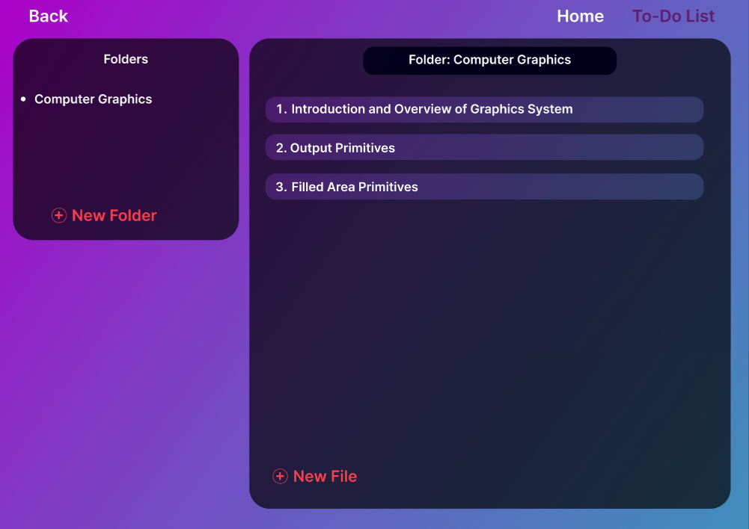
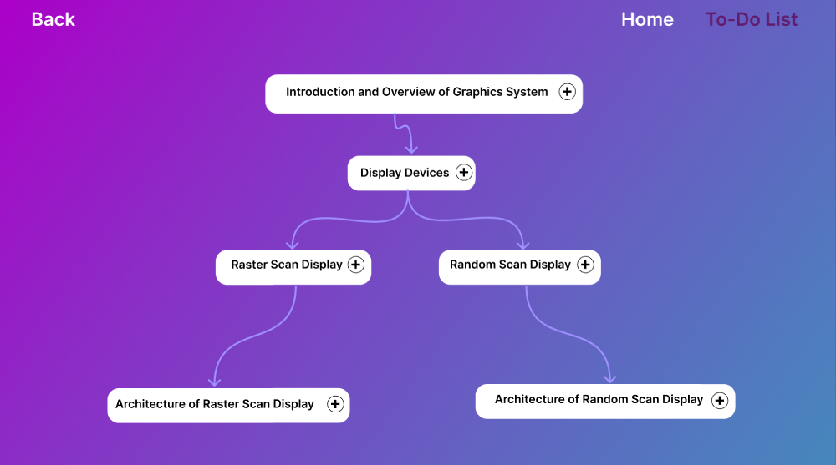
M
A
N
A
G
E
R
T
A
S
K

Slide 11
References
[1] https://todo.microsoft.com/tasks/
[2] https://www.taskade.com/
[3] https://www.javatpoint.com/html-tutorial
[4] https://www.javatpoint.com/css-tutorial
[5] https://www.javatpoint.com/javascript-tutorial
[6] https://nodejs.org/en/docs
[7] https://www.figma.com/

